Slide 1
Andrews - Information Visualisation
https://keithandrews.com/talks/2022/2022-10-27-ivis-dh/#4
Introduction to Information Visualisation
Prof. Keith Andrews
ISDS, Graz University of Technology, Austria
Web site:
https://isds.tugraz.at/keith/
Slides:
http://keithandrews.com/talks/2022/2022-10-27-ivis-dh/
Course Notes:
http://courses.isds.tugraz.at/ivis/ivis.pdf
27 Oct 2022, Centre for Information Modelling, University of Graz.

Slide 2
Andrews - Information Visualisation
https://keithandrews.com/talks/2022/2022-10-27-ivis-dh/#4
Sales Data as a Table
Month | Salesperson A | Salesperson B
2012-01 | 28,366 | 23,274
2012-02 | 27,050 | 21,732
2012-03 | 29,463 | 23,845
2012-04 | 32,561 | 28,732
2012-05 | 28,050 | 24,023
2012-06 | 30,100 | 26,089
2012-07 | 22,343 | 19,026
2012-08 | 21,506 | 17,903
2012-09 | 24,664 | 19,387
2012-10 | 28,842 | 23,490
2012-11 | 30,621 | 25,873
2012-12 | 36,254 | 28,490

Slide 3
Andrews - Information Visualisation
https://keithandrews.com/talks/2022/2022-10-27-ivis-dh/#4
Sales Data as a Line Chart
40,000
Salesperson A
Salesperson B
35,000
Sales in €
30,000
25,000
20,000
15,000
2012-01
2012-02
2012-03
2012-04
2012-05
2012-06
2012-07
2012-08
2012-09
2012-10
2012-11
2012-12
Month

Slide 4
Andrews - Information Visualisation
https://keithandrews.com/talks/2022/2022-10-27-ivis-dh/#4
Information Visualisation
“Let my dataset change your mindset.”
[Hans Rosling, title of talk at TED@State, 03 Jun 2009]
Information visualisation (InfoVis) is the visual presentation of abstract in- formation spaces and structures, together with accompanying interactions, so as to facilitate their rapid assimilation and understanding.
[ Hans Rosling; Stats that Reshape Your Worldview; TED 2006 Talk, 22 Feb 2006.
http://ted.com/talks/hans_rosling_shows_the_best_stats_you_ve_ever_seen.html ]

Slide 5
Andrews - Information Visualisation
https://keithandrews.com/talks/2022/2022-10-27-ivis-dh/#4
Visualisation
The broader field of visualisation has three main sub-fields:
InfoVis:
Information Visualisation (InfoVis) deals with abstract information struc- tures, such as hierarchies, networks, or multidimensional spaces.
GeoVis:
Geographic Visualisation (GeoVis) is map-based. The data typically has in- herent 2d or 3d spatial coordinates, and is generally shown in relation to a map.
SciVis:
Scientific Visualisation (SciVis) typically involves concrete (3d) objects, for example a medical scan of part of the body, or a simulation of air flow around an aircraft wing. SciVis visualisations often depict flows, volumes, and surfaces in (3d) space.
Data Visualisation (DataVis) = InfoVis + GeoVis.
Visual Analytics = DataVis (frontend) + Analytics (backend).

Slide 6
Andrews - Information Visualisation
https://keithandrews.com/talks/2022/2022-10-27-ivis-dh/#4
Interactive Information Visualisation
Visual Representation + Interaction.
Two main use cases:
Explore (Analyse): help researchers explore and analyse.
Explain (Present): present results and insights to a wider public.

Slide 7
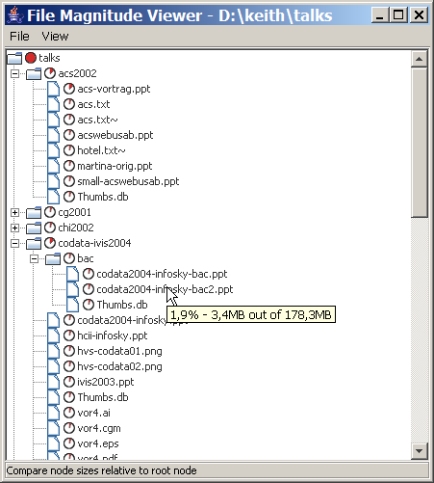
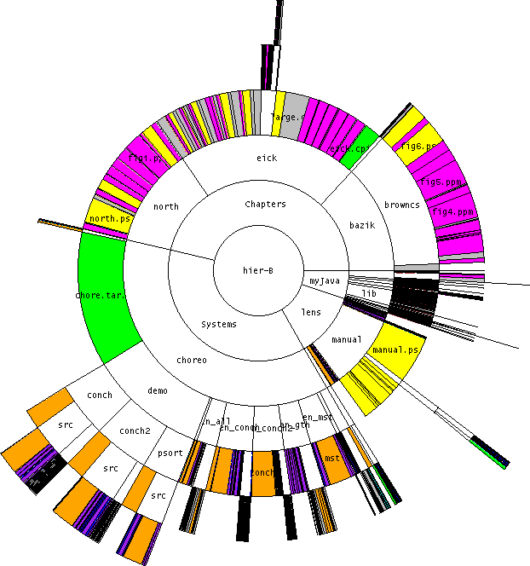
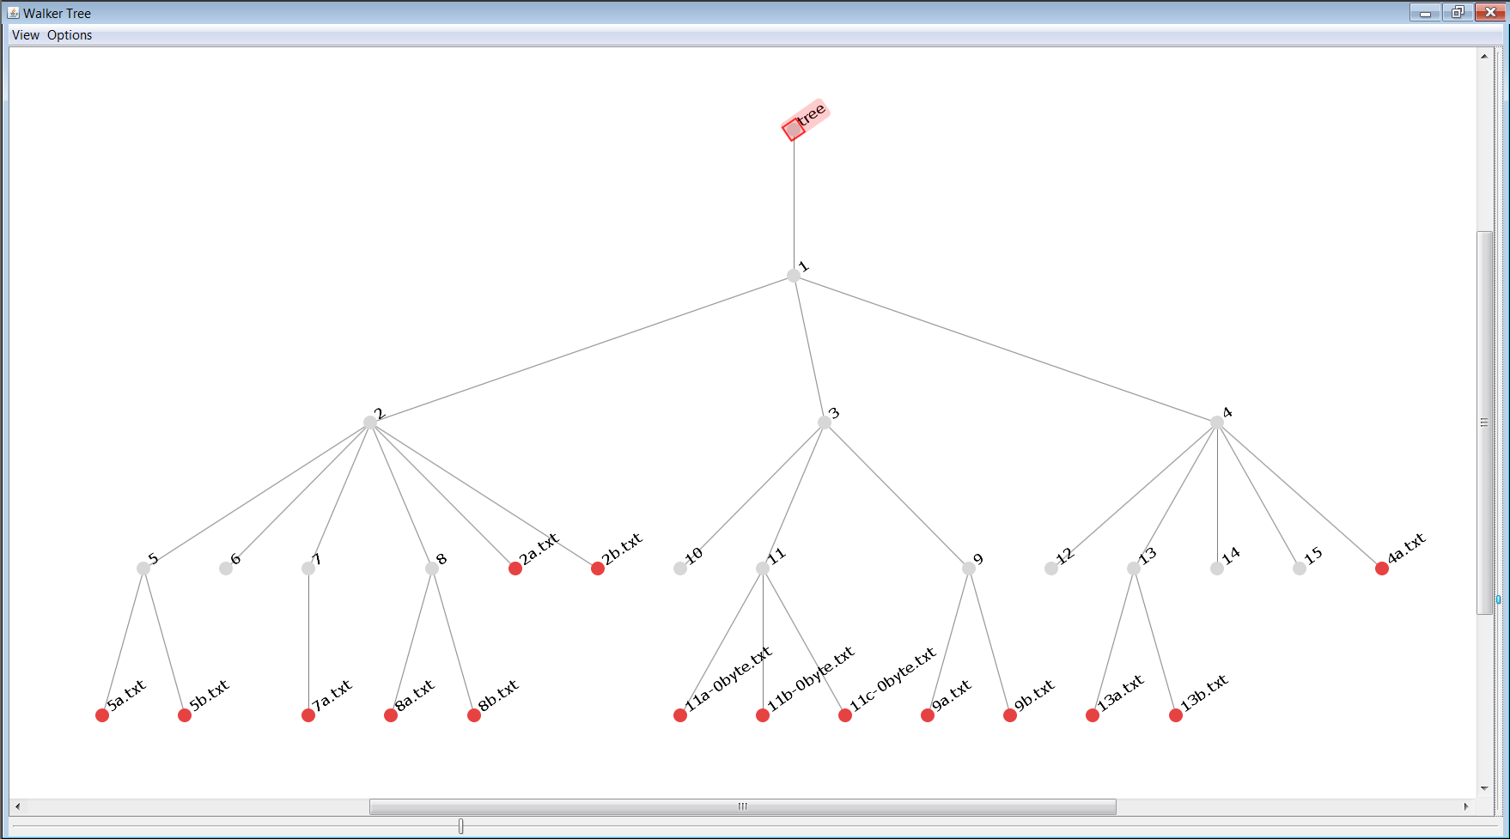
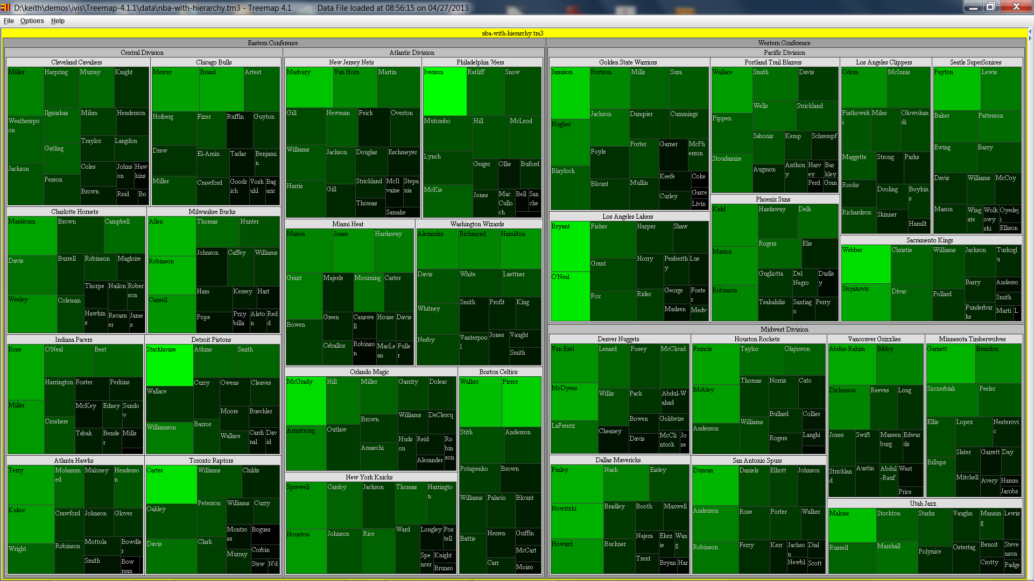
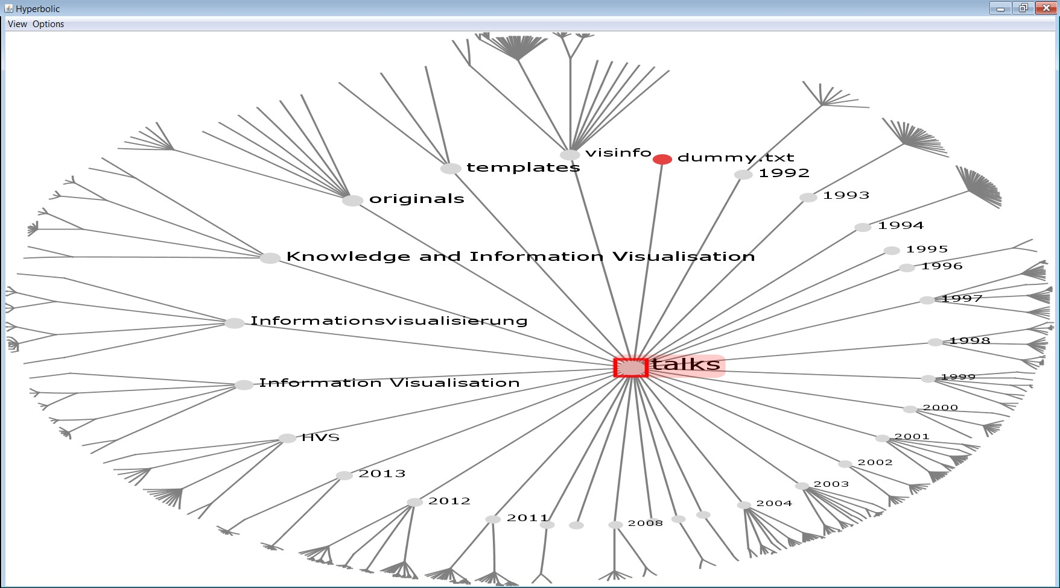
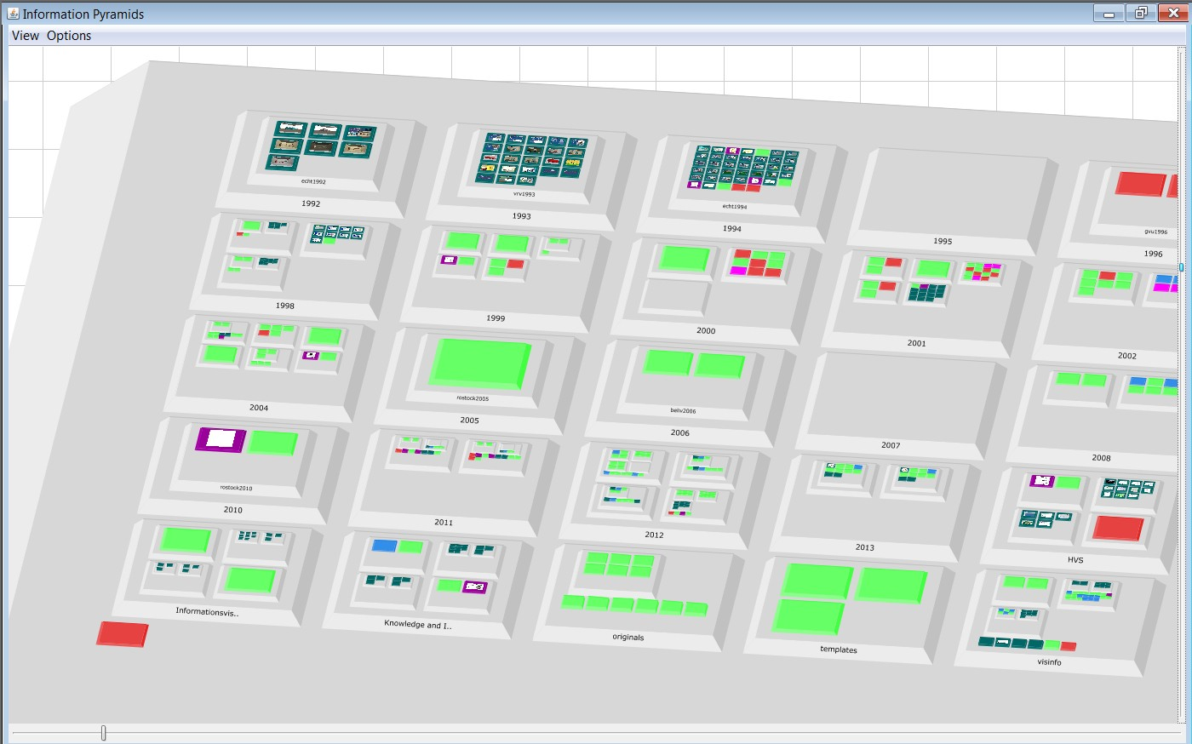
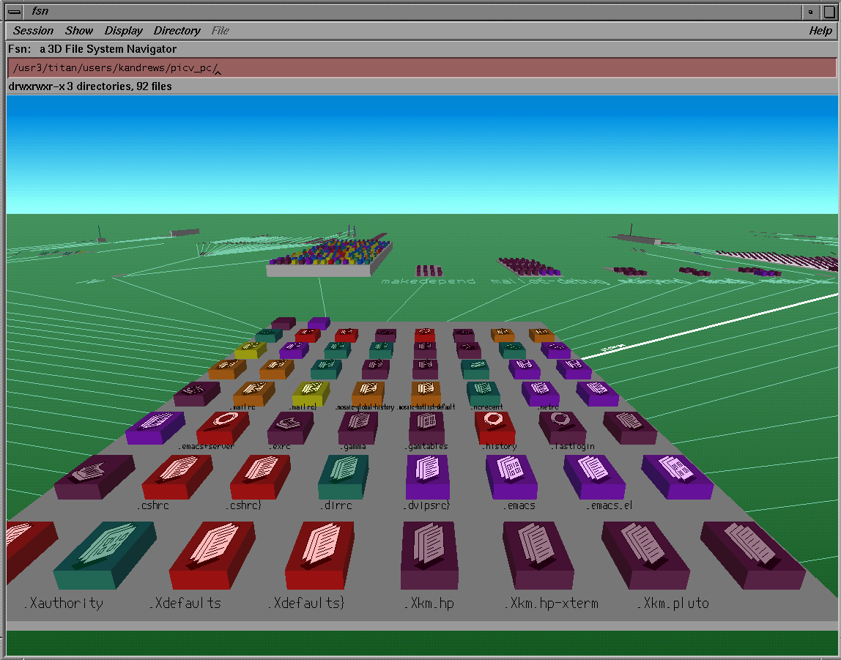
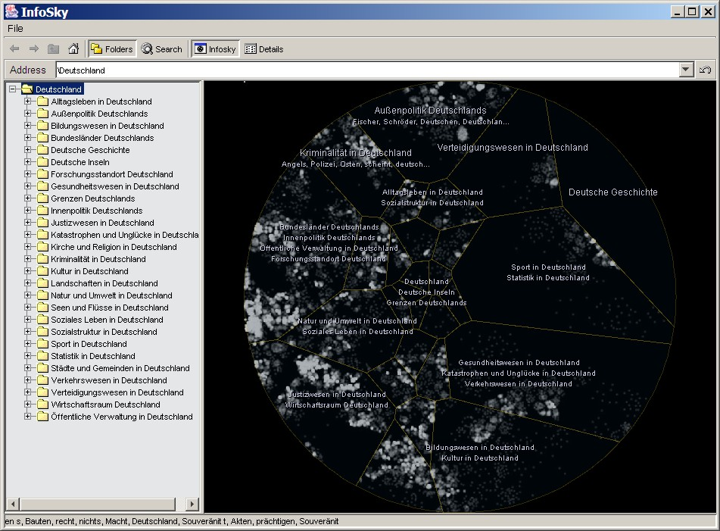
Andrews - Information Visualisation
https://keithandrews.com/talks/2022/2022-10-27-ivis-dh/#4
Visualising Hierarchies

Slide 8
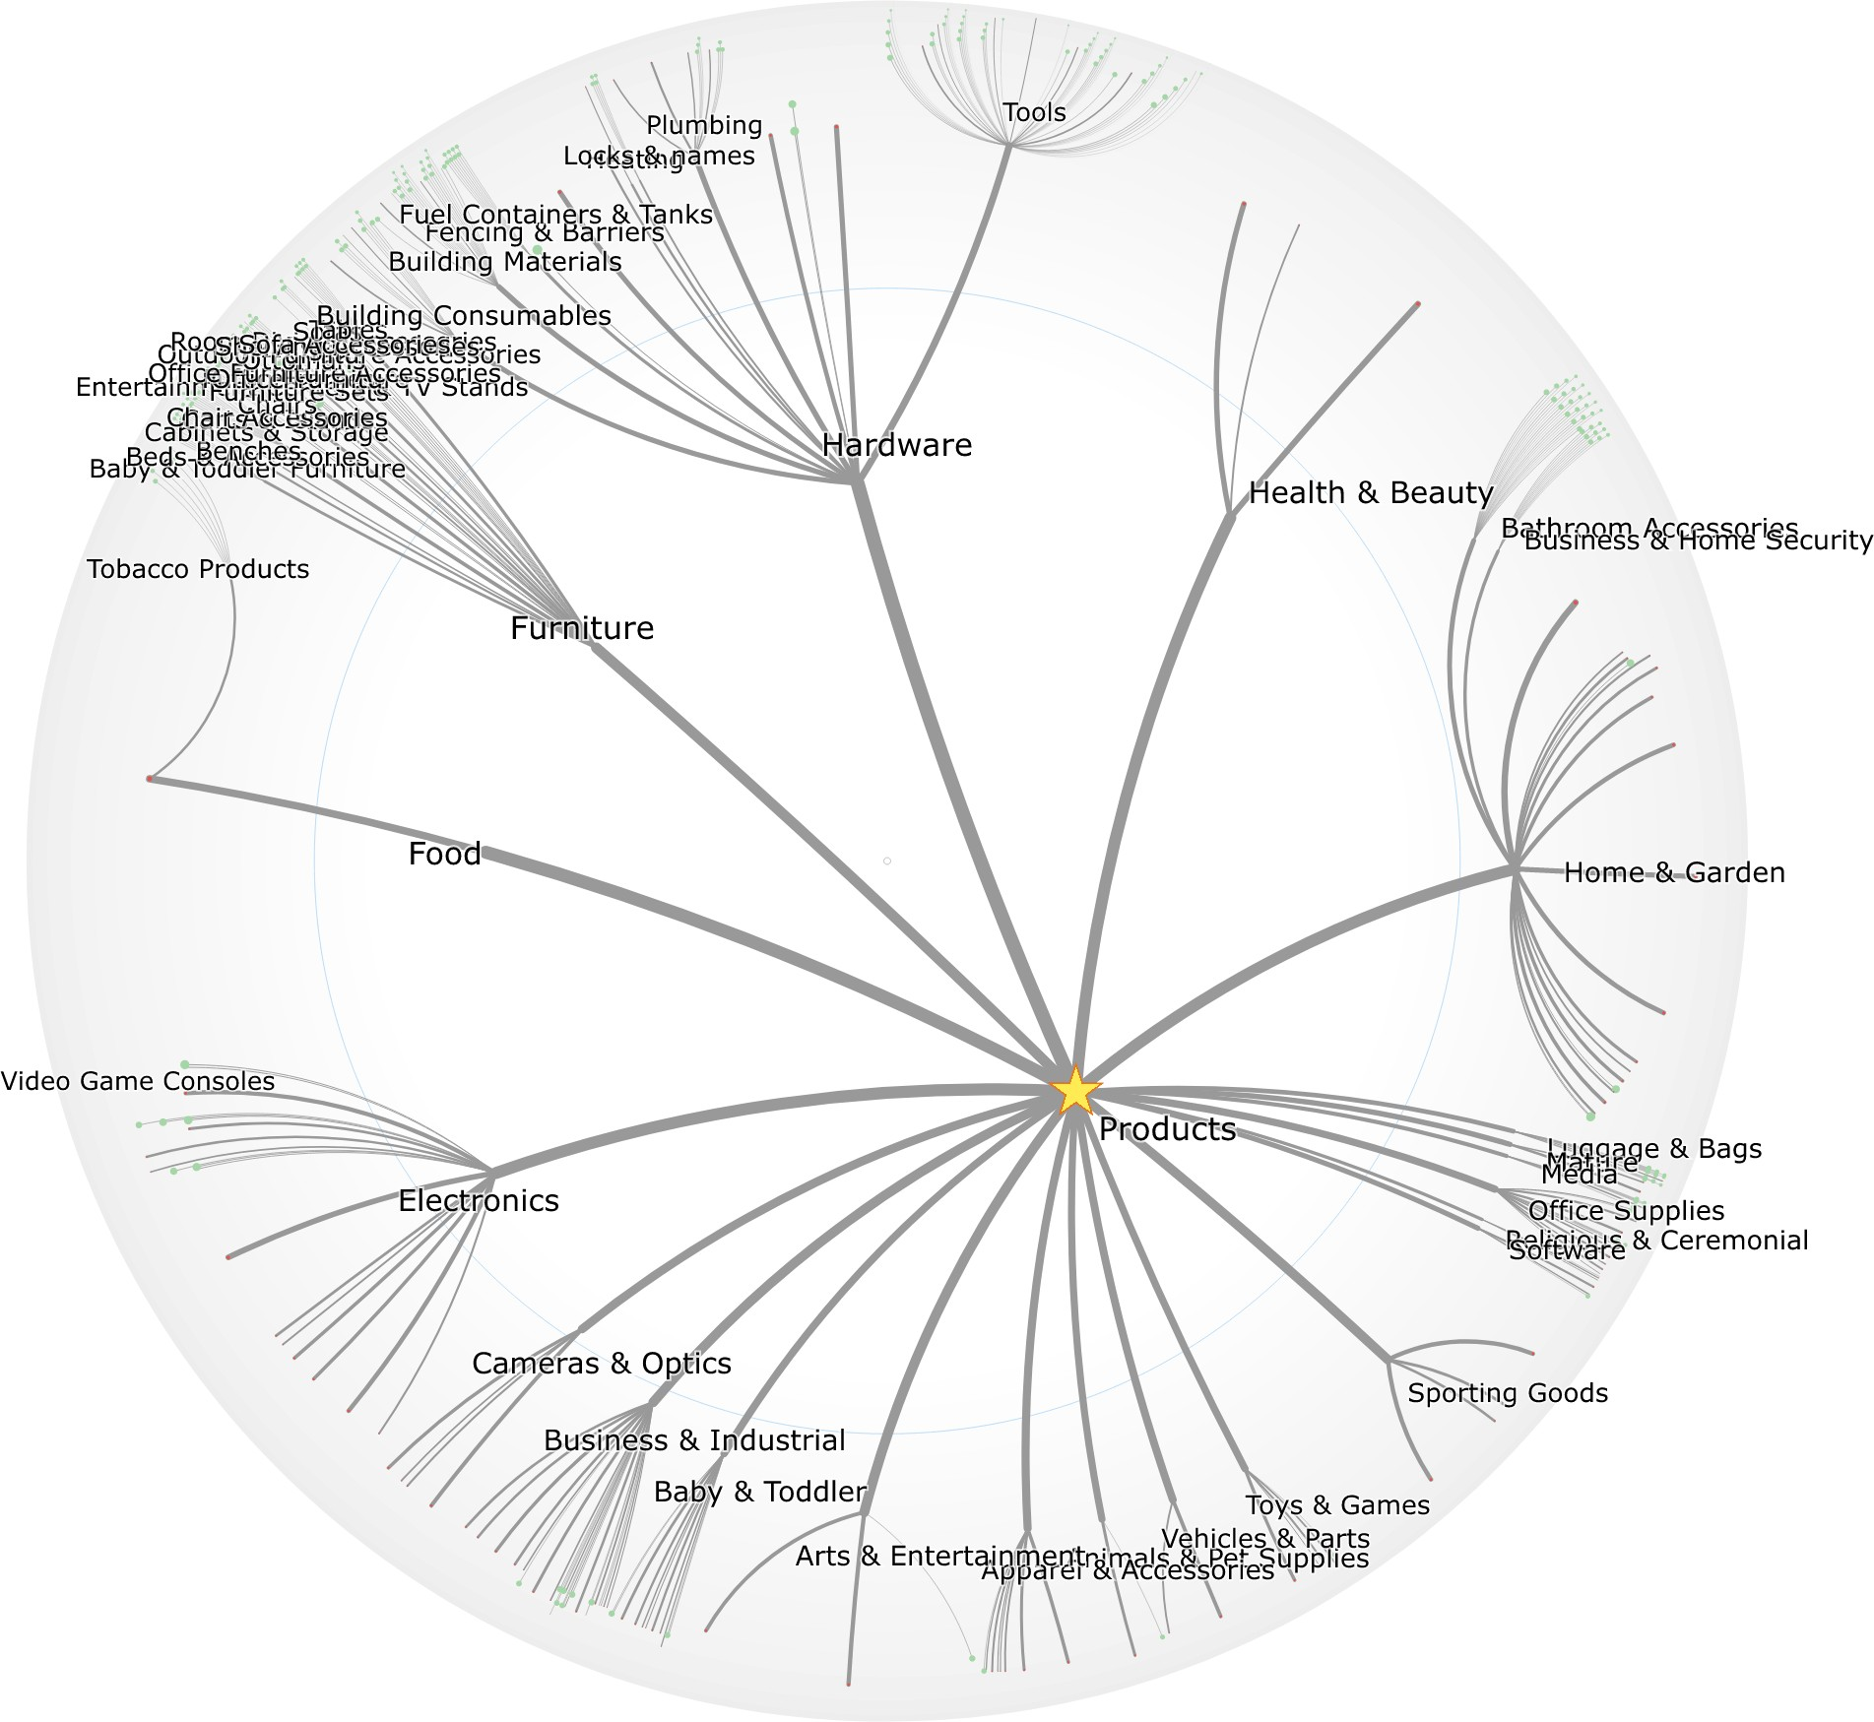
Andrews - Information Visualisation
https://keithandrews.com/talks/2022/2022-10-27-ivis-dh/#4
Hyperbolic Browser
D3-Hypertree [Michael Glatzhofer and Keith Andrews, 2019] https://keithandrews.com/demos/ivis/hypertree/hypertree-products/ https://hyperbolic-tree-of-life.github.io/ https://github.com/glouwa/d3-hypertree https://observablehq.com/@glouwa

Slide 9
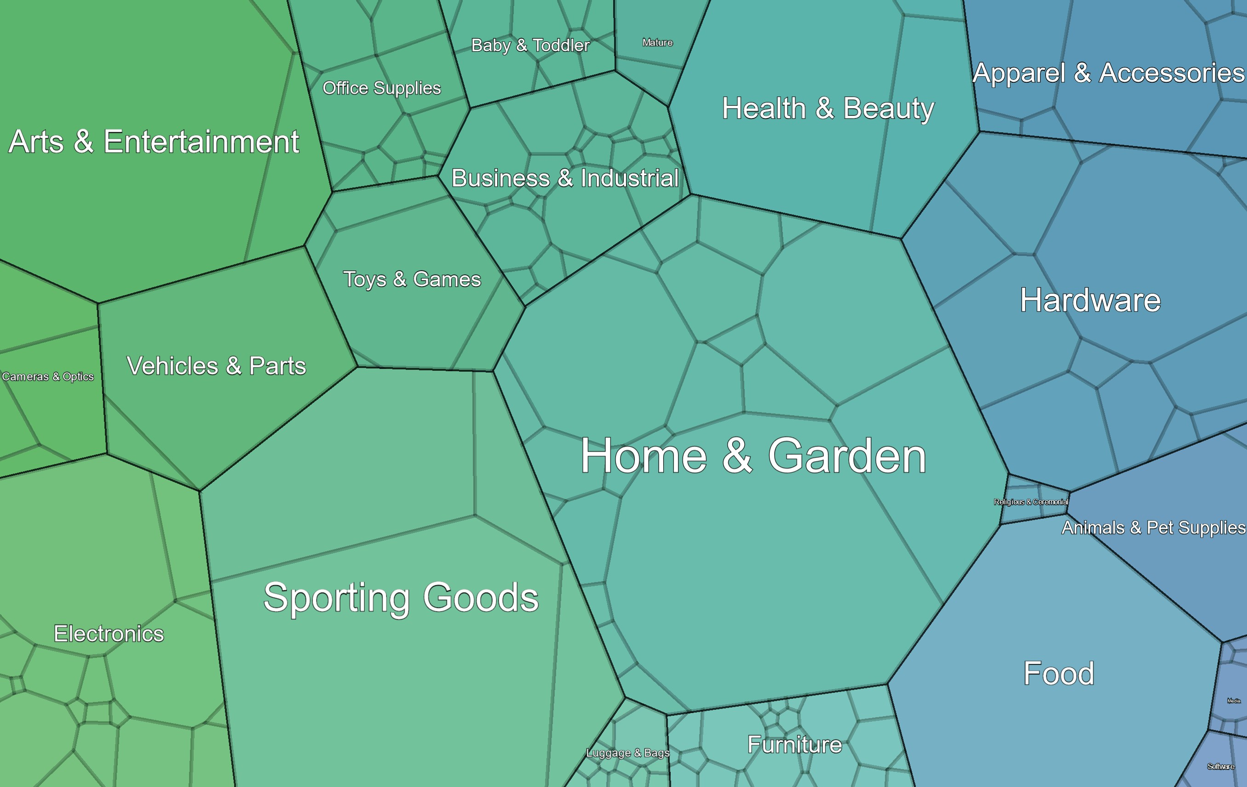
Andrews - Information Visualisation
https://keithandrews.com/talks/2022/2022-10-27-ivis-dh/#4
Voronoi Treemap
VoroTree [Christopher Oser and Keith Andrews, 2022] https://somestudentcoder.github.io/vorotree/ https://github.com/somestudentcoder/vorotree

Slide 10
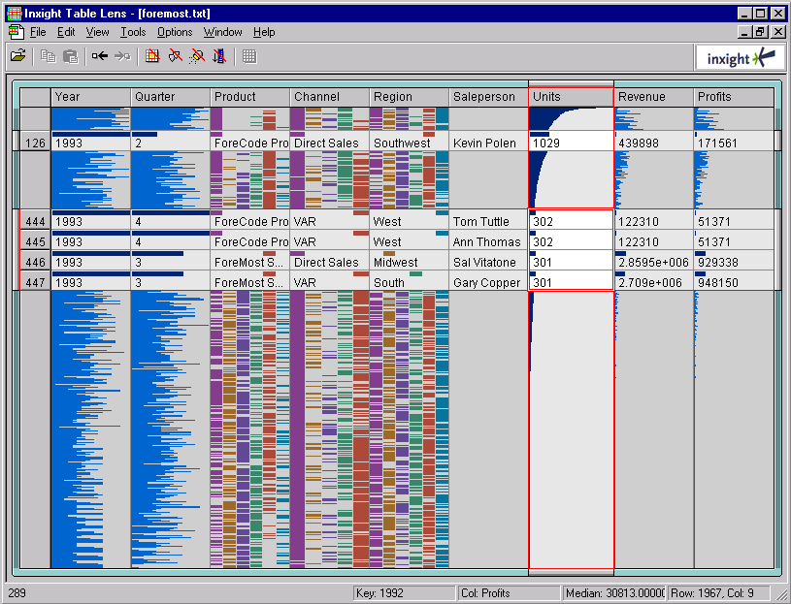
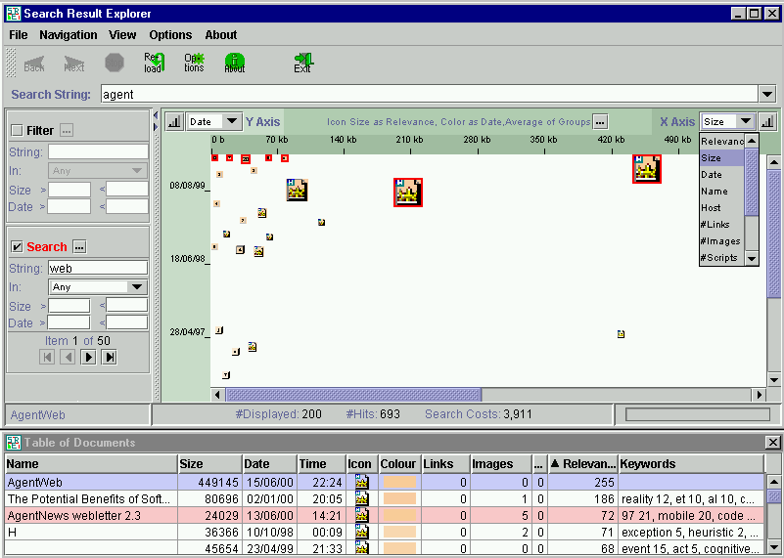
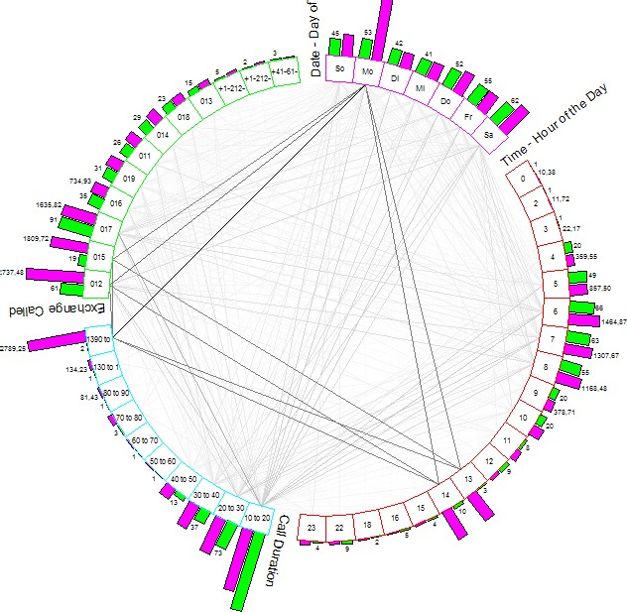
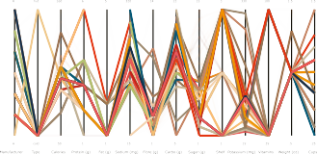
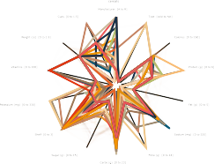
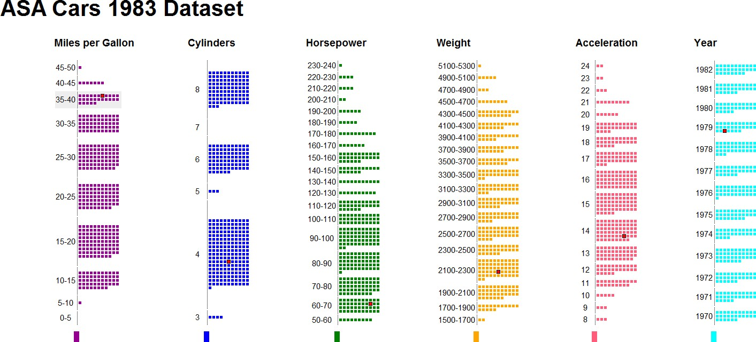
Andrews - Information Visualisation
https://keithandrews.com/talks/2022/2022-10-27-ivis-dh/#4
Visualising Multidimensional Metadata

Slide 11
Andrews - Information Visualisation
https://keithandrews.com/talks/2022/2022-10-27-ivis-dh/#4
Multidimensional Data as a Table
City | Net Purchasing Power | Prices (incl. rent) | Net Wages | Working Time [hours per year] | Vacation [paid working days per year] | Time Required for Big Mac [minutes] | Time Required for iPhone 4S 16gb [hours] | City Break | Inflation 2011
Amsterdam | 90.1 | 69.1 | 69.4 | 1755 | 24 | 15 | 44 | 720 | 2.48
Athens | 60.5 | 58.2 | 40.0 | 1822 | 22 | 29 | 86 | 590 | 3.10
Auckland | 82.9 | 67.8 | 63.5 | 1852 | 20 | 15 | 51 | 580 | 4.03
Bangkok | 31.4 | 48.2 | 17.4 | 2312 | 7 | 36 | 165 | 550 | 3.81
Barcelona | 78.6 | 65.6 | 58.7 | 1760 | 29 | 18 | 52 | 740 | 3.05
Beijing | 29.9 | 51.8 | 18.0 | 1979 | 9 | 34 | 184 | 730 | 5.42
Berlin | 97.1 | 64.1 | 70.1 | 1742 | 28 | 16 | 56 | 720 | 2.48
Bogotá | 40.7 | 47.0 | 22.0 | 1981 | 15 | 52 | 142 | 540 | 3.42
Bratislava | 50.7 | 47.1 | 27.3 | 1884 | 23 | 31 | 126 | 490 | 4.08
Brussels | 78.5 | 68.8 | 59.5 | 1729 | 20 | 19 | 54 | 730 | 3.47
Budapest | 32.0 | 50.4 | 18.1 | 1912 | 22 | 49 | 206 | 740 | 3.90
Buenos Aires | 46.2 | 47.7 | 25.4 | 1830 | 13 | 45 | 187 | 620 | 9.78
Bucharest | 34.0 | 34.8 | 13.5 | 1836 | 26 | 57 | 230 | 370 | 5.81
Caracas | 25.7 | 85.4 | 23.4 | 1878 | 17 | 80 | 272 | 830 | 26.09
...
UBS Prices and Earnings Survey 2012 [UBS, 2012]
https://www.ubs.com/microsites/prices-earnings/open-data.html

